Slide 1
Network forensic

Slide 2
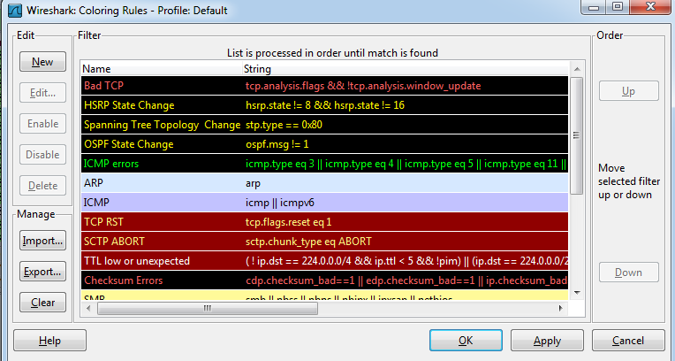
View/Coloring rules
1- Màu sắc phân biệt gói tin
Notes:
https://www.wireshark.org/docs/dfref/i/ip.html

Slide 3
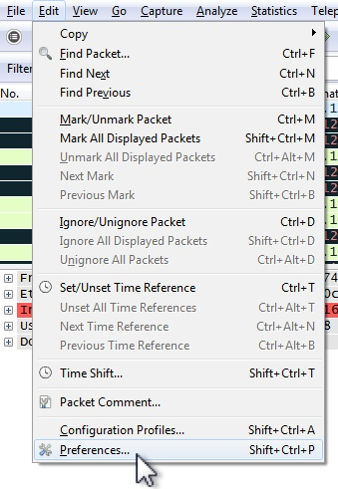
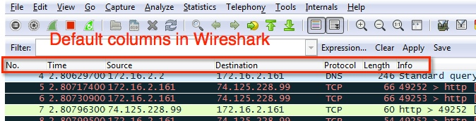
2- Thay đổi mặc định các trường được hiển thị: edit --> Preferences
Mặc định các cột này sẽ được hiển thị

Slide 4
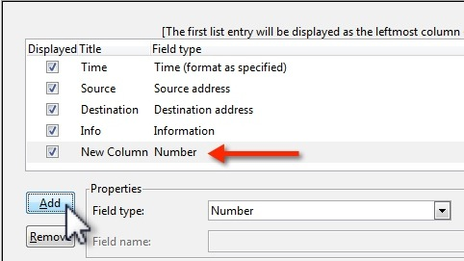
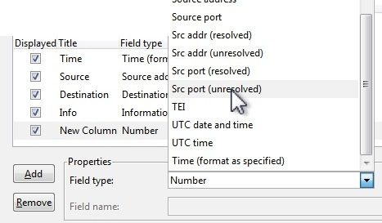
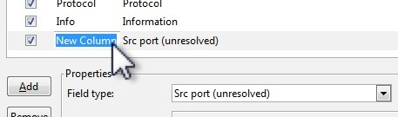
3- Thêm cột. Sau đó kéo thả để các cột thông tin tương ứng gần nhau

Slide 5
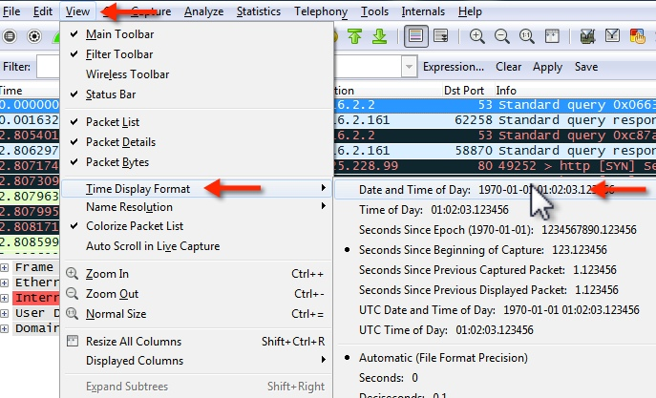
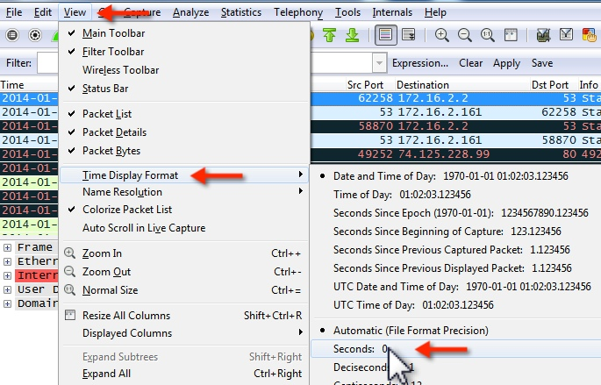
4- Nên chọn định dạng thời gian này

Slide 6
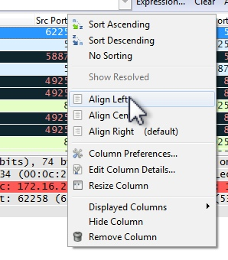
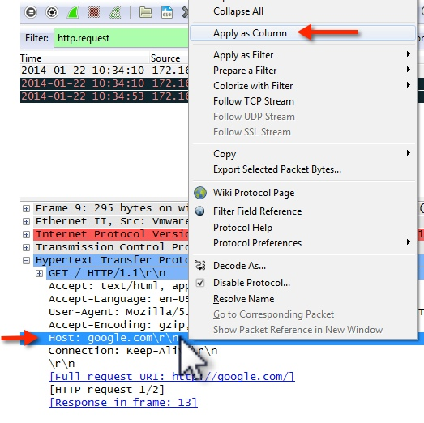
5- Chỉnh tiêu đề của cột
6- Chèn thêm cột Host

Slide 7
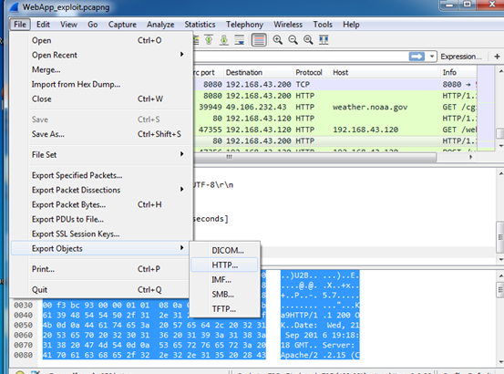
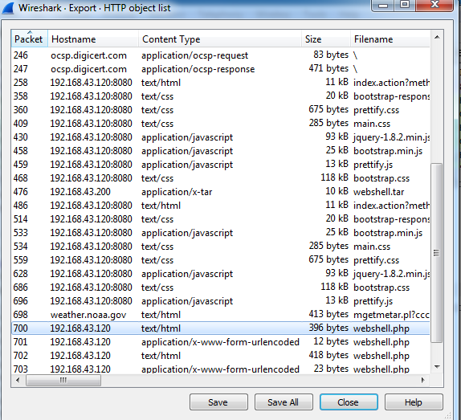
7- Recover file: File -> Export Objects -> http để tìm script độc hại

Slide 8
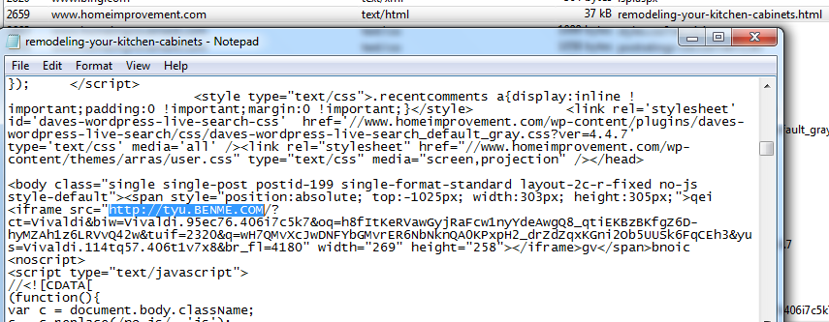
File -> Export Objects -> http -> save để tìm script độc hại

Slide 9
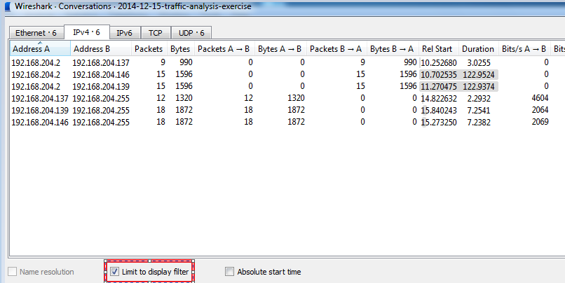
Hiển thị gói tin ở dạng thu gọn

Slide 10
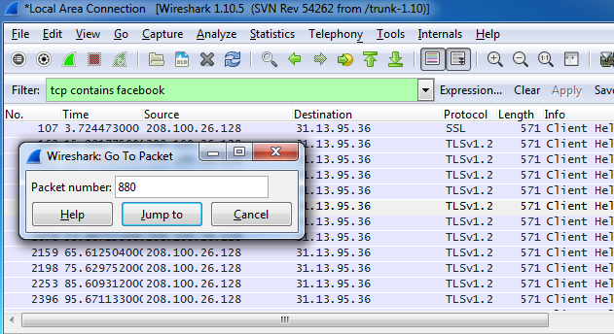
Ctrl + G

Slide 11
Phân tích gói tin

Slide 12
Network Analysis
Network Analysis for Security
Important activities for incident responders and security analysts
Related to many security activities
Network monitoring
To detect an on-going incident
Network forensic
To find evidence in the specific incident
To recover a system
Malware analysis
To discover the capability of a malware
Sending important data to a malicious server
Bot command and control
Notes:
https://twitter.com/malware_traffic

Slide 13
Network Analysis
Flow-based (NetFlow…)
Packet-based (Wireshark…)
Some futures of Wireshark
“Analyze” → follow TCP Stream
  See data from a TCP stream in the way the application layer sees it.
“Statistics” → Conversation
  Separated by protocols, shows statistics for each protocol: amount of data, time, etc. …
“Filters”
  To see one aspect of the capture (i.e. packets from a port)

Slide 14
Network Analysis
Examples of filters
“tcp.port==443
  TCP connections with src or dst port = 443.
  adding src or dst option: tcp.srcport / tcp.dstport
  tcp.port in {443 4430..4434}
“tcp.flags.syn==1
  TCP SYN packets
  include ACK packets. Remove ACK packets → add tcp.flags.ack==0 using &&
“ip.src==10.0.012
  shows connections with source IP=10.0.0.12
  Changing src to dst will change to destination IP
Combination of above:
  “||”, “&&”
  Ex: ip.src==10.0.0.2 && tcp.dstport==80

Slide 15
ip.addr == 192.168.204.137 and tcp.port in {80 25}
There is no simple way to figure out if there is a malware infection, by looking at capture files, as there are tons of different malware types out there and they all behave differently.
There are some indicators, like a lot of connections or a lot of traffic form a single client (Statistics -> Conversations), "strange" DNS queries, etc

Slide 16
You could also check NBNS traffic (NBNS = NetBIOS Name Service), because Windows (and sometimes other) hosts will register their hosts through NBNS after they connect to the network. In Wireshark, type nbns or smb in the filter box, and scroll through the NBNS traffic until you find the NBNS registration traffic, => hiển thị các máy tham gia kết nối mạng

Slide 17
To find HTTP requests using the HEAD or GET methods:
  http.request.method in {"HEAD" "GET"}
  http.request.method == "GET“
  http.request.method == "POST"
  http contains https://www.malware.org
  To check all the HTTP packets that contain a ZIP fle, use http matches "\.zip"
  && http.request.method == "GET"

Slide 18
Network Analysis - Exercises
Exercise 1 (Telnet): 01-telnet.pcap
Question
Reconstruct the telnet session
  Q1: 192.168.0.1 is a telnet ……………. ?
    192.168.0.2 is a telnet ……………. ?
  Q2: Who logged into 192.168.0.1 ?
  Username………..? Password ………….?
  Q3: After logged in, what did the user do ?

Slide 19
Network Analysis - Exercises
Exercise 1 (Telnet): 01-telnet.pcap
Question
Reconstruct the telnet session
  Q1: 192.168.0.1 is a telnet …Server. ?
    192.168.0.2 is a telnet … Client …. ?
  Q2: Who logged into 192.168.0.1 ?
  Username… fake.? Password … password.?
  Q3: After logged in, what did the user do ?
/sbin/ping www.yahoo.com; ls –a; exit

Slide 20
Network Analysis - Exercises
Exercise 2 (Massive TCP SYN): 02-massivesyn1.pcap, 02-massivesyn2.pcap
Question
Point out the difference in the two captures
Q1: 02-massivesyn1.pcap is a …………………….attempt.
Q2: 02-massivesyn2.pcap is a …………………….attempt.
(tip: pay attention to Src and Dst Port)

Slide 21
Network Analysis - Exercises
Exercise 2 (Massive TCP SYN): 02-massivesyn1.pcap, 02-massivesyn2.pcap
Question
Point out the difference in the two captures
Q1: 02-massivesyn1.pcap is a … port scan ….attempt.
Q2: 02-massivesyn2.pcap is a … SYN flood (DoS) …….attempt.
(tip: pay attention to Src and Dst Port)

Slide 22
Network Analysis - Exercises
Exercise 3 (Comparing traffic): 03-risa.pcap , 03-jim.pcap
Scenario
You are an IT admin of company X. You get a report that Jim ( a new employee) can not browse or email with his laptop. After researching, you found that Risa, sitting next to Jim, can browse without any problem.
Question
Compare the capture files to find out why Jim’s machine is not online ?
Jim must ………………………………………………in order to connect.
(tip: pay attention to the first ARP packet)

Slide 23
Network Analysis - Exercises
Exercise 3 (Comparing traffic): 03-risa.pcap , 03-jim.pcap
Scenario
You are an IT admin of company X. You get a report that Jim ( a new employee) can not browse or email with his laptop. After researching, you found that Risa, sitting next to Jim, can browse without any problem.
Question
Compare the capture files to find out why Jim’s machine is not online ?
Jim must …change gateway to 192.168.0.10…..…in order to connect.
(tip: pay attention to the first ARP packet)

Slide 24
Network Analysis - Exercises
Exercise 4 (Chatty Employees): 04-chat.pcap
Question
  Q1: What protocol is being used ?
  Q2: This is conversation between …………………@hotmail.com and
  ………..……..@hotmail.com
  Q3: What do they say about you (sysadmin) ?
(tip: Your chat log can be monitored by network admin)

Slide 25
Network Analysis - Exercises
Exercise 4 (Chatty Employees): 04-chat.pcap
Question
  Q1: What protocol is being used ? http (msm messenger)
  Q2: This is conversation between ……..tesla_brian@hotmail.com and
  …tesla_thomas@hotmail.com
  Q3: What do they say about you (sysadmin) ? Try to hack into server…
(tip: Your chat log can be monitored by network admin)

Slide 26
Network Analysis - Exercises
Exercise 5 (Suspicious FTP activity): 05-ftp1.pcap
Question
  Q1: FTP server’s IP address is ? …………………………….
  Q2: FTP client’s IP address is ?...............................................
  Q3: FTP Err Code 530 means ?.................................................
  Q4: 10.234.125.254 is attempting to ……………………………………….
(tip: How many login errors are allowed within a minute ?)

Slide 27
Network Analysis - Exercises
Exercise 5 (Suspicious FTP activity): 05-ftp1.pcap
Question
  Q1: FTP server’s IP address is ? 10.21.70.151….
  Q2: FTP client’s IP address is ?..... 10.234.125.254...................
  Q3: FTP Err Code 530 means ?.... Login incorrect..................
  Q4: 10.234.125.254 is attempting to: dictionary bruce force attack…….
(tip: How many login errors are allowed within a minute ?)

Slide 28
Network Analysis - Exercises
Exercise 6 (Unidentified Traffic): 06-Foobar.pcap
Question
  Q1: Which application uses TCP/6346 ? …………………………………….
  Q2: How may servers was 10.1.4.176 trying to connect to ?......................
  Q3: Which machines could 10.1.4.176 succesfully connect to (at least at the TCP/IP level) ?....................................................

Slide 29
Network Analysis - Exercises
Exercise 6 (Unidentified Traffic): 06-Foobar.pcap
Question
  Q1: Which application uses TCP/6346 ? …gnutella………….
  Q2: How may servers was 10.1.4.176 trying to connect to ?....81........
  Q3: Which machines could 10.1.4.176 succesfully connect to (at least at the TCP/IP level) ?....2 (213.66.32.81; 65.34.1.56)........................................
Tip:
ip.src=10.1.4.176 → conversation → limited by filter → IP =81
ip.src=10.1.4.176 && tcp.ack ==1 → conversation → IP =2

Slide 30
Network Analysis - Exercises
Exercise 7: 07-arp.pcap
Question
  Q1: What type of attack was happening ?
  Q2: What type of packet was malicious in this attack ?
  Q3: What is the attacker’s IP address and MAC address ?
  Q4: What is the victim’s IP address and MAC address ?
  Q5: What is the victim’s role in this network ?
  Q6: Was this attack successful or not ?
  Q7: What kind of countermeasures may be useful for this attack ?

Slide 31
Network Analysis - Exercises
Exercise 7: 07-arp.pcap
Question
  Q1: What type of attack was happening ? ARP spoofing
  Q2: What type of packet was malicious in this attack ? Packet No 25: ARP
  Q3: What is the attacker’s IP address and MAC address ?
  Q4: What is the victim’s IP address and MAC address ?
  Q5: What is the victim’s role in this network ? (webserver)
  Q6: Was this attack successful or not ? not
  Q7: What kind of countermeasures may be useful for this attack ?
- Static ARP; ARP monitoring; smart switch detect MAC change
192.168.132.131
…5d:27
Victim (webserver)
gateway
client
192.168.132.130
…98:e7
192.168.132.254
…a5:f3
172.16.253.200
attacker
Tip: line 8 → port 80; line 13 → GET/HTTP; line 50-51 → new MAC adr=.98.e7

Slide 32
Network Analysis - Exercises
Scenario
Alice is a web master. The other day, she browsed several web sites using the same PC for document uploading. Unfortunately one of the sites which she visited was defaced and her PC was infected with malware but she was unaware of the infection.
Exercise 8: 08-gumblar1.pcap
Question
  Q1: What kind of malicious activity did this malware perform ?
  Q2: What is the malicious server’s IP address ?

Slide 33
Network Analysis - Exercises
Scenario
Alice is a web master. The other day, she browsed several web sites using the same PC for document uploading. Unfortunately one of the sites which she visited was defaced and her PC was infected with malware but she was unaware of the infection.
Exercise 8: 08-gumblar1.pcap
Question
  Q1: What kind of malicious activity did this malware perform ?
  Stole FTP account and sent to a server
  Q2: What is the malicious server’s IP address ? 67.215.246.34
67.182.231.84
webserver with FTP server
gateway
client
67.215.246.34
10.0.7.254
10.0.7.250
malicious server

Slide 34
https://vncsirts.herokuapp.com/drills/

